Slide 1
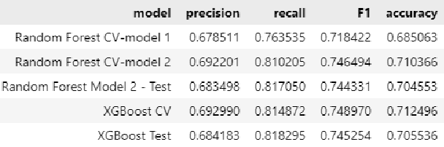
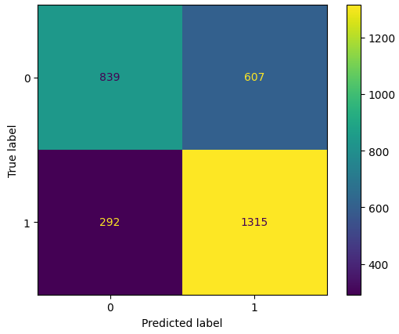
Machine Learning Model for New York City TLC Project
Executive summary report: Commission Prepared by Automatidata
The purpose of the project is to predict taxi cab fares before each ride. At this point, the focus is to build a machine learning model that identifies riders/rides that tip generously.
This project objective is to build and evaluate a random forest model that predicts whether a rider/ride would tip in an amount that is 20% or greater (generous rides) than the fare amount. Taxi driver may use the model to accept a ride.
We built a random forest model with good performance on predicting generous rides/tippers. Then we fined tuned the model’s hyperparameters further improving it.
As a third step we build a XGBoost model. The improved random forest model performed comparably vs the XGBoost model. The results of both models with validation vs. test data were similar, although XGBoost was the best. f1 score is the primary performance measure.
1) Deploy model to taxi drivers for evaluation
2) Communicate the model capabilities and limitations. The model is prone to give twice as much false positive vs false negative results
3) Further evaluate the model’s performance with new data on field.

